Slide 1
Unit 08 Assignment 01
The Uses and Features of Mobile Apps
Notes:
Hello my name is David, this is my presentation on the use and features of two different mobile apps.

Slide 2

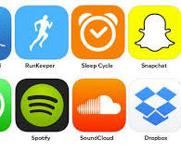

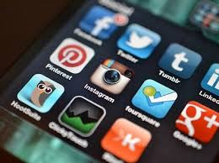
What is a Mobile App
A Mobile Phone App is an application which has been designed to run on a mobiles OS.
Mobile apps are faster.
They offer quicker access to information.
Notes:
Mobile Phone Apps are applications which have been designed to run on a mobiles OS. These applications normally run faster then accessing it through a web browser, this is more convenient for the user by making a simple process to access the information that the user needs.

Slide 3
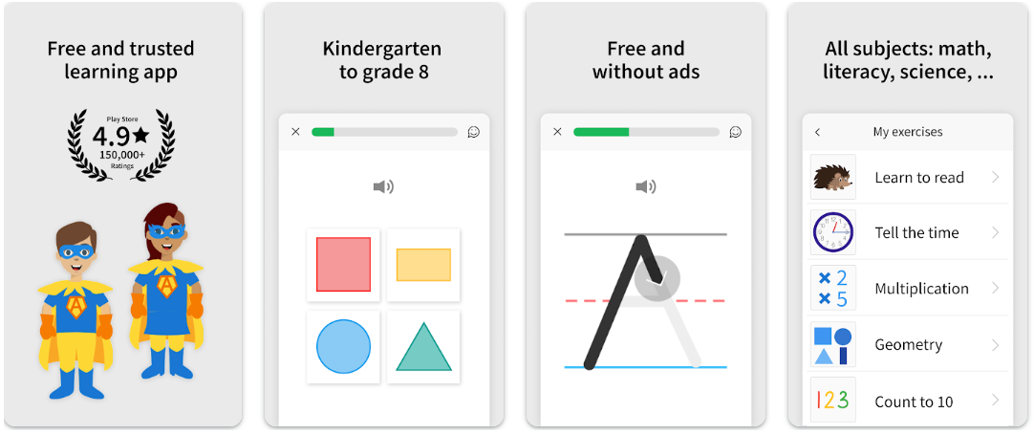

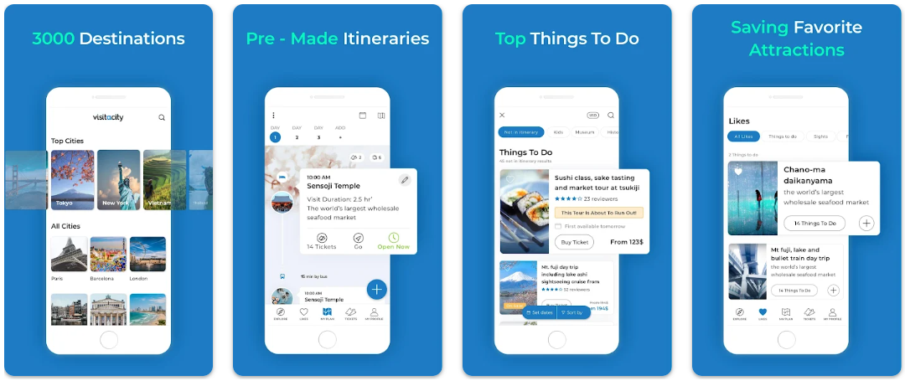

My apps
The two apps that I will be comparing
App 1 link
ANTON: Curriculum & Home-school
My first mobile app is an educational app.
App2 link
Visit A City
My second app is for tourists visiting new locations.
Notes:
These are the two apps I've chosen to review. ANTON, and Visit A City. My first one ANTON is a educational app.
My second app Visit A City is for tourists visiting new locations.

Slide 4

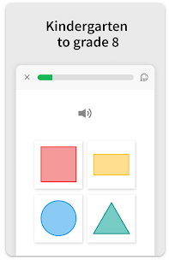
App 1 Educational ANTON
What ANTON does
Anton educates its uses in many different areas.
How does it achieve the desired purpose
By having interactive puzzles to solve which keeps the user interested.
Notes:
What ANTON does.
It educates its uses in I wide variety of different topics like maths English or other languages science and many other options.
How does it achieve the desired purpose
It's achieved this goal by having interactive lessons and breaking concepts down into more handleable size for someone who is new to the topic, it can have fun games and puzzles to help teach you different subjects which keeps user engaged and in the optimum state for learning.

Slide 5
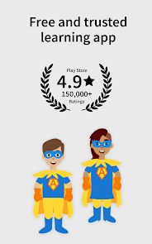
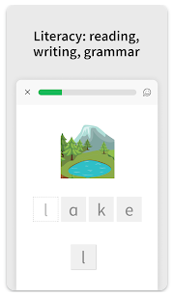
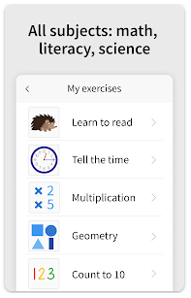
The uses and features of ANTON
The uses are children in education it has interactive lessons to teach
many topics like math's and English.
It is a free app.
the purpose of each typical use
ANTON is used for educating young children
its purpose is to increase the knowledge of its users.
Notes:
The uses and features of ANTON.
The users of ANTON are people aged 5 to 15 normally home schooled ANTON is designed to help young children learn in an interactive way and teach new concepts to them.
The features of ANTON include interactive puzzles and problems to solve in the areas of maths English and many others. ANTON is also free to download and use.
The most typical use of ANTON is for educating younger children in schools or at home, it can also be used to help grasp complicated topics and teach in a interactive way which can be easier for some young people.
the purpose of this is to educate and increase their knowledge, help the users to learn in the best way possible well keeping it exciting and fun.

Slide 6
user requirements and user-friendliness
The user requirements are a device to install and run.
The user friendliness is good because it has clear writing, and it is easy to see.
dependence on hardware
All it requires is a sufficiently powerful smartphone.
platforms and compatibility
ANTON performs relatively well and is compatible with most phone.
how this affect the usability and intended use by the audience
By limiting the devices can be used.
by constraining the usability of the app.
Notes:
user requirements and user-friendliness. The user requirements are a device to install and run the app and the knowledge to install and use the app. The user friendliness is good because it has clear writing, and it is easy to see what is on the screen.
dependence on hardware. All ANTON needs to run is a sufficiently powerful smartphone and Internet connexion.
platforms and compatibility. ANTON performs relatively well although can't have some usability issues and is compatible with most phone operating systems.
how this affect the usability and intended use by the audience
These could limit the usability if the user has a lower performing device. This could also constrain the usability of the app and the interaction the uses getting.

Slide 7
Some of the unique features of Anton two the mobile app.
Anton uses the touch screen of the mobile device to increase the interaction of the user this is unique to the mobile device because most laptops and computers do not have touch screens. This feature can help the user to engage with the lesson and make it easier to navigate.
Antons unique interaction with the phone by using the touch screen to help young children with concepts it's very powerful.
Notes:
Some of the unique features of Anton two is mobile app.
Anton uses the touch screen of the mobile device to increase the interaction of the user this is unique to the mobile device because most laptops and computers do not have touch screens and the web version of the site does not have these features. This feature can help the user to engage with the lesson and make it easier to navigate. This feature, being able to use the touch screen is a part of the hardware of the mobile device. it can increase the user experience considerably and this is unique to the mobile app.
this feature can be used for teaching concepts like math's and engineering two younger children by having a more interactive learning environment which is boosted by the use of unique hardware of mobile devices.
Antons unique interaction with the phone by using the touch screen to help young children with concepts it's very powerful.

Slide 8
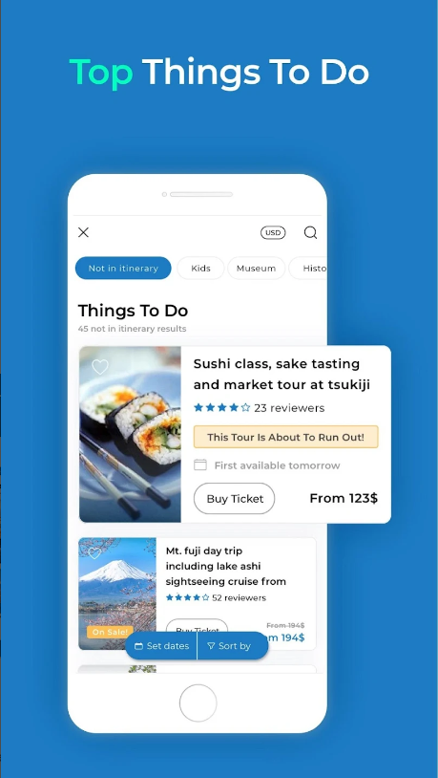
App 2 Tourist Visit A City
What Visit A City does
It tries to advance you terrorism or holiday experience.
How does it achieve the desired purpose
by showing all the local locations and their reviews.
Notes:
What Visit A City does.
It advances the travelling and sightseeing experience in than you city or country you are visiting.
How does it achieve the desired purpose.
It achieves this goal by showing all the historical or sightseeing locations near you as well as activities, it also shows the reviews for all these sites so you can select the best option for you.

Slide 9
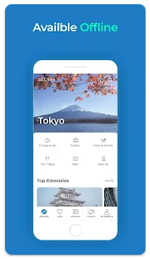
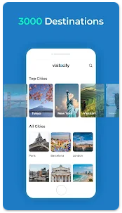
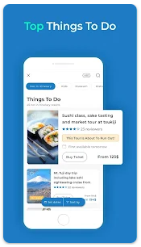
The uses and features of Visit A City
It helps tourists to navigate the city that visiting.
it makes sure that you don't meet miss anything at the new.
the purpose of each typical use
To give information about each location.
To allow for a personalised set of locations for the day in the new location.
Notes:
The uses and features of Visit A City.
The users of this app would be people on holidays tourists or sightseers. The age of the uses of this app would be people old enough to visit other cities or countries. The features of this app are it is free to download and has all the historical locations as well as activity and sightseeing locations which you can browse and select to organise your day, it has ratings for each play so you can select the best locations for your trip. You can also book locations through the app.
the purpose of each typical use. The purpose of having reviews for different locations is so that it educates the user and give them the best knowledge about the location before they go there so they can make the best decision. The purpose of having all the options out in front of you is so you can create a personalized activity list for the day, and plan it out to your personal liking and needs.

Slide 10
user requirements and user-friendliness
Adequately powerful device and it's easy to use.
dependence on hardware
It needs a powerful enough device with Internet connexion.
platforms and compatibility
It's a simple and easy to use and performs relatively well and it's compatible with most phones.
how this affect the usability and intended use by the audience
This can limit the use of the device without Internet. because it requires a sufficiently powerful device to run on the audience might be people with higher quality phones.
Notes:
user requirements and user-friendliness. all the user needs is a mobile phone or tablet to use the app the app is easy to use with simple navigation.
dependence on hardware. all it requires is a sufficiently powerful processor and Internet connexion,.
platforms and compatibility. Performs relatively well and it is compatible with all modern smartphone operating systems and accessible from most app stores.
how this affect the usability and intended use by the audience. This constricts usability by limiting to somewhere with Internet connexion and requiring a sufficiently powerful device to run it on.

Slide 11
Some of the unique features of Visit A City two the mobile app.
Some of the features that make Visit A City unique to the app oh it's sharing capabilities; you can share your trip with you contacts.
another feature as it can use your location to help you navigate the city, you're visiting this uses the GPS in your phone.
Notes:
Some of the unique features of Visit A City two the mobile app.
Some of the features that make Visit A City unique to the app oh it's sharing capabilities; you can share your trip with you contacts.
another feature as it can use your location to help you navigate the city, you're visiting this uses the GPS in your phone. these GPS capabilities are a unique part to the mobile device in the app to increase functionality and usability for its uses.

Slide 12
Review of the features of both mobile apps and comparing them
App 1 Educational ANTON
Anton is used for educating children or young adults in English maths
it teaches in a simple way with games and challenges to improve the user experience.
App 2 Tourist Visit A City
The second app visit to city is designed to improve the experience of visiting new locations
all the locations have been rated by previous visitors.
you can pre book locations through the app and see open hours.
Comparison
Anton is an educational app then visitor city is a tourism app.
Anton is a educational based app.
in a way they're both educational author visitor city isn't a educational based app.
Notes:
Review of how the features of both mobile apps and comparing them
App 1 Educational ANTON.Anton is used for educating children or young adults in English maths of languages as well as history and science and many more topics it teaches in a simple way with games and challenges to improve the user experience and to engage the user in the lesson.
App 2 Tourist Visit A City. The second app visit to city is designed to improve the experience of visiting new locations it has all the sightseeing and historical locations as well as activities. all the locations have been rated by previous visitors, and you can pre book locations through the app and see open hours.
Comparison. Antone is an educational app then visitor city is a tourism app, Anton has a simple to navigate layout with engaging topics to learn although visitor city has lots of locations too visit and information about them in a way they're both educational author visitor city isn't a educational based app, it is more just giving the most common options other people have chosen and information they have given.

Slide 13
The strengths and weaknesses of the apps
App 1 Educational ANTON
Strengths
It is easy to navigate it's good for educating younger children and teaching new concepts.
It can be helpful to teach children and keep them engaged in topics.
Its use of unique hardware on the mobile device like the touch screen.
weaknesses
it requires knowledge to install and use the application, it also could not be usable without Internet.
App 2 Tourist Visit A City
strengths
it improves the experience of holidays or sightseeing and can make it easier to see the activities and historical places nearby.
Some of the strengths of visitor city its use of the users GPS as well as other unique features of the mobile app's interaction with the mobile device.
Its connection to other science and inbuilt capabilities of booking out hotels and locations.
Weaknesses
weaknesses it requires Internet connexion and knowledge to use the app.
Notes:
The strengths and weaknesses of the apps
App 1 Educational ANTON
Strengths. It is easy to navigate unused and is very good for educating young children and teaching new concepts.
Its use of unique hardware on the mobile device like the touch screen.
Weaknesses. it requires a device to use it on and knowledge to install and use the application, it also could not be usable without Internet.
App 2 Tourist Visit A City
Strengths. it improves the experience of holidays or sightseeing and can make it easier to see the activities and historical places nearby. And it can be used to pre book locations and give more information about the place you're visiting. And by having feedback for each location it helps to inform the user on which location they would like to go.
Some of the strengths of visitor city its use of the users GPS as well as other unique features of the mobile app's interaction with the mobile device.
Its connection to other science and inbuilt capabilities of booking out hotels and locations.
Weaknesses. the weaknesses are at requires an Internet connexion and a sufficiently powerful device to run on, and you need to know how to install and use the app.

